Slide 1

Introduction to Data Science/Machine Learning
University of Wisconsin Milwaukee
Fall 2025
Sammie Omranian

Slide 2

Girls Who Code – Week 5
Data Visualization
Using matplotlib and seaborn to make data come alive 💡
🧠 Goal: Turn data tables into easy-to-understand pictures.

Slide 3
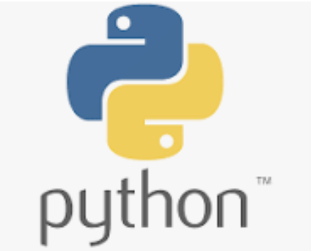
Agenda
Today’s Plan:
Why we visualize data
Meet matplotlib & seaborn
Create your first charts (line & bar)
Visualize a real dataset – Titanic 🛳️
Reflection – What did we learn?
🕒 We’ll learn → code → see results → share discoveries!

Slide 4
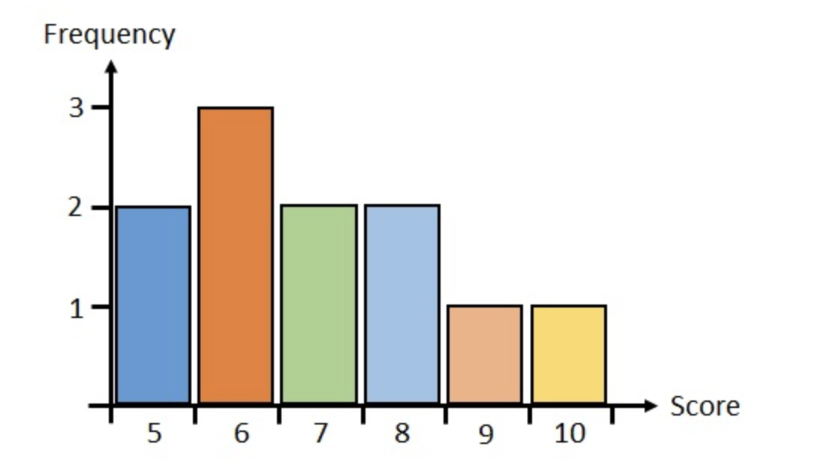
Why visualize data?
We visualize data to…
See patterns and trends
Spot differences quickly
Tell a story with numbers
📊 Example:

Slide 5
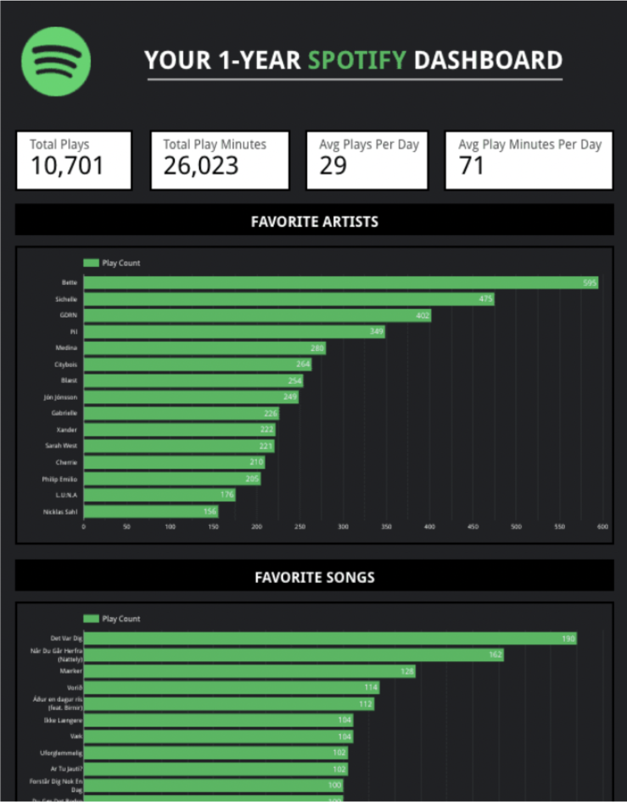
Data Visualization
What do you notice first in this dashboard?
What story does it tell about this listener?
Would you understand it as easily if it were just a table of numbers?

Slide 6
Data Visualization
Key takeaway:
Visuals make data easy to understand.
Charts help us see patterns, not just read them.
You can tell your story with data — just like Spotify does!

Slide 7


Meet matplotlib & seaborn
matplotlib: the basic drawing tool 🖊️
For simple, customizable plots
seaborn: built on matplotlib 🎨
Prettier and faster
🧠 Think: matplotlib = pencil ✏️ → seaborn = colored markers 🖍️

Slide 8
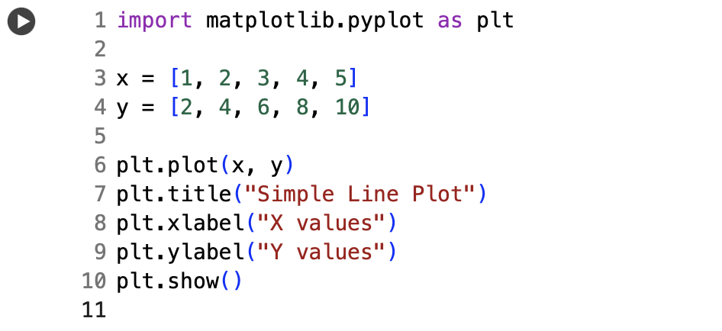
Practice: Our First Chart (matplotlib)
🧩 Your Turn:
Change y to squares [1,4,9,16,25]
Add a title with your name

Slide 9
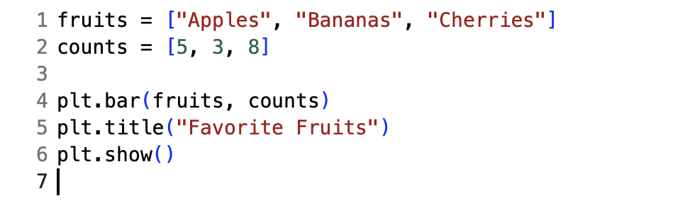
Practice: Bar Chart
🧩 Your Turn:
Add more fruits 🍉
Change colors: color="orange"

Slide 10
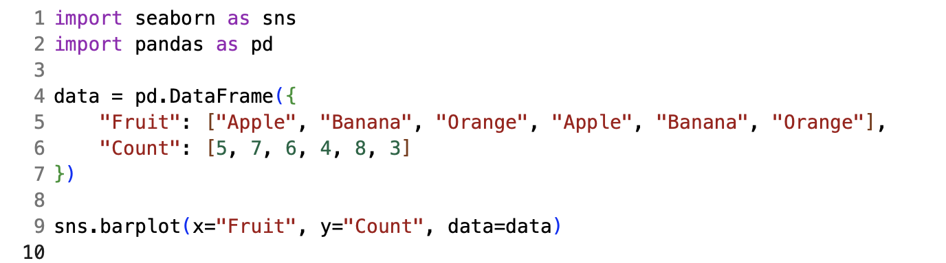
Using seaborn
🧩 Your Turn:
Add a new fruit 🍓
Try sns.histplot(data["Count"])
Notes:
Each bar tells how common a value is. It’s like counting how many times each score or number shows up — but in picture form!

Slide 11

Google Colab – Our Coding Hub Where we’ll write, run, and share all our Python code

